Slide 1
Implementation of Football Analytics with Data Revolution
Presented By:
KANISHK KUMAR
Submitted to: Senior Developer, Search Quality Dept, Yandex, Bardukov Anatoly Andreevich

Slide 2
INTRODUCTION
Football is the most popular sport in the world, watched by kids, teenagers and adults. As Football becomes more popular by the minute, teams are constantly looking for new creative ways to improve their performance and compete on a higher level.
This research aims to determine the Pass Count, Likely Passes, Predictability and Estimate the Pass Difficulty in Football Matches. To achieve our goal, we would start by defining the research thesis, extracting requirements and studying the subject.
In this thesis, I will take you on how to analyze Football Matches Data using Python. In this case, I will analyze the 2018/2019 FA Women's Super League match.
To analyze, there is the use Machine Learning models like K-Means Clusters, Logistic Regression and Sequential Neural Networks. Finally, we investigate Football Data using Python language and implement a machine learning model.
This thesis investigates the Predictability and Difficulty of Passes in Football Data by Machine Learning models. To achieve this objective, I train an ML model and draw ROC Curves.

Slide 3
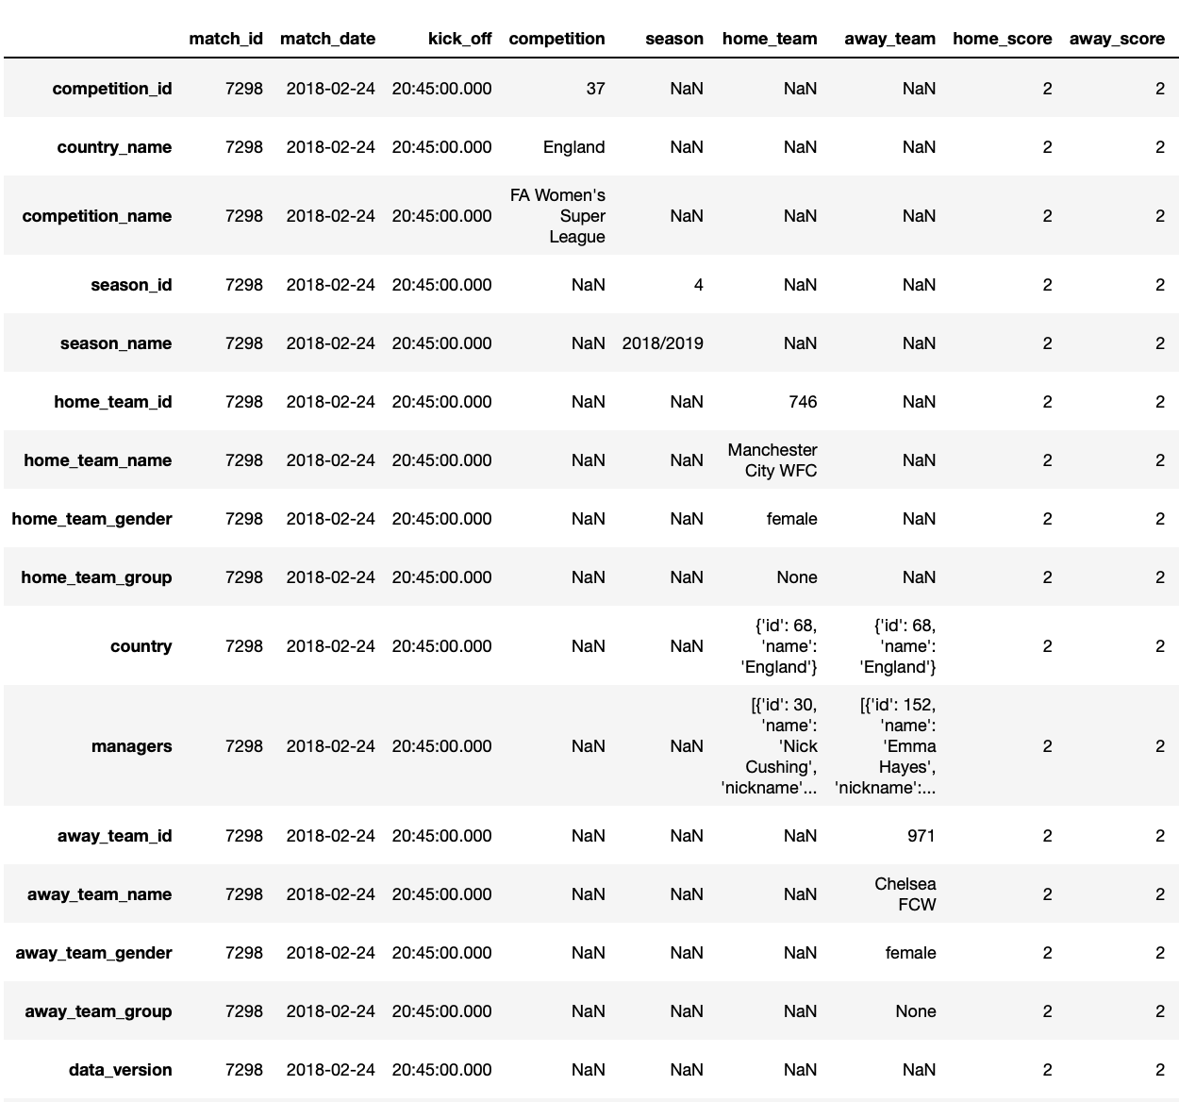
Football Match DataFrame

Slide 4
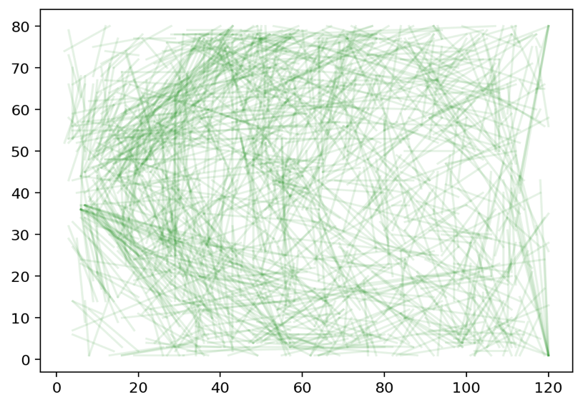


BASIC PASS MAP VISUALIZATION
Match ID = 19783
which is the
FA Women’s Super League Match
between
Chelsea FCW vs Everton LFC.
Chelsea FCW
Everton LFC

Slide 5
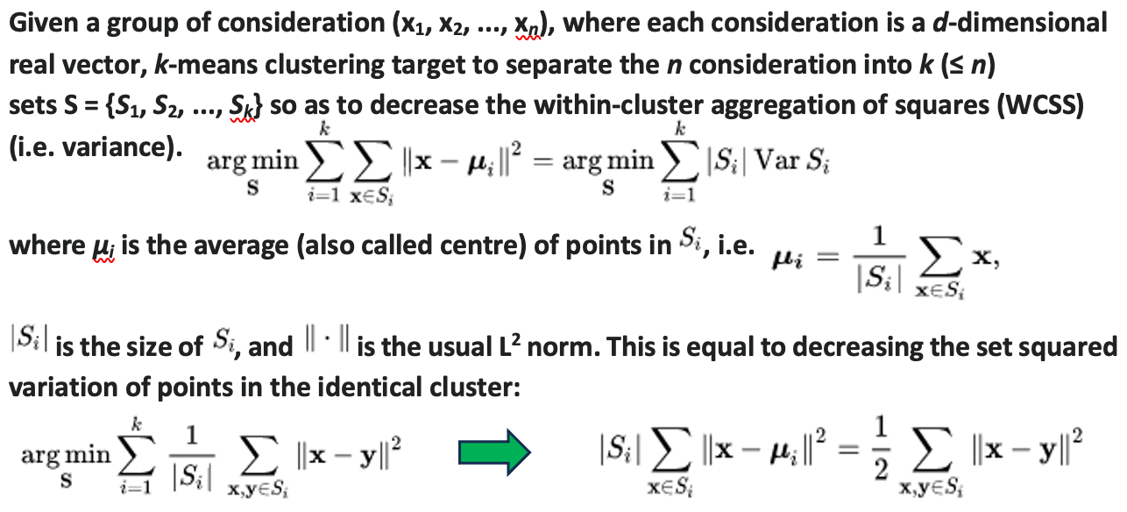
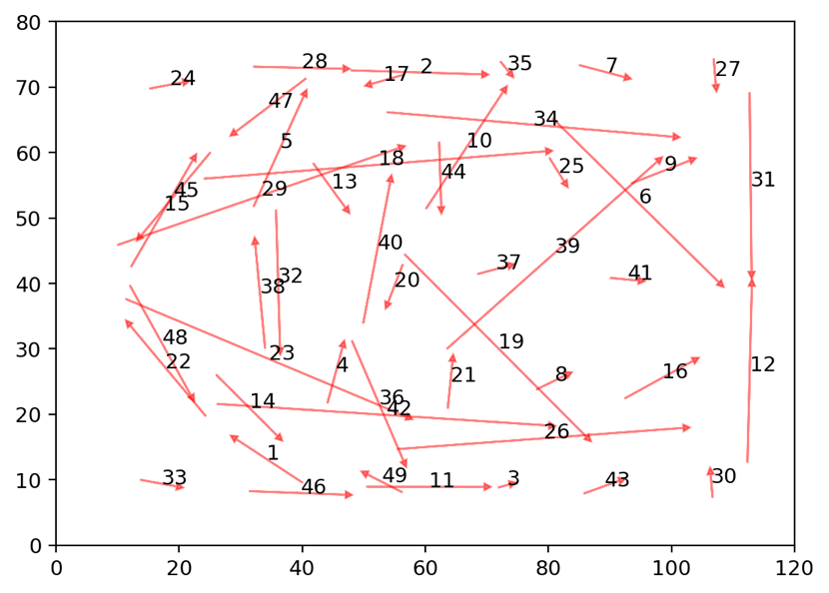

PASS CLASSIFICATION USING K-MEANS CLUSTERING
Cluster Center of the Training Data of Passes location

Slide 6
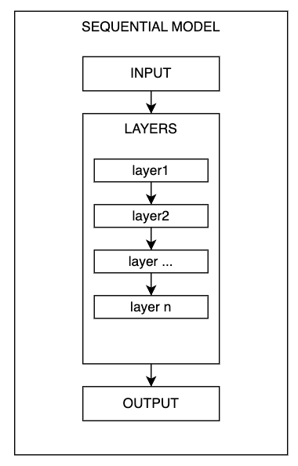
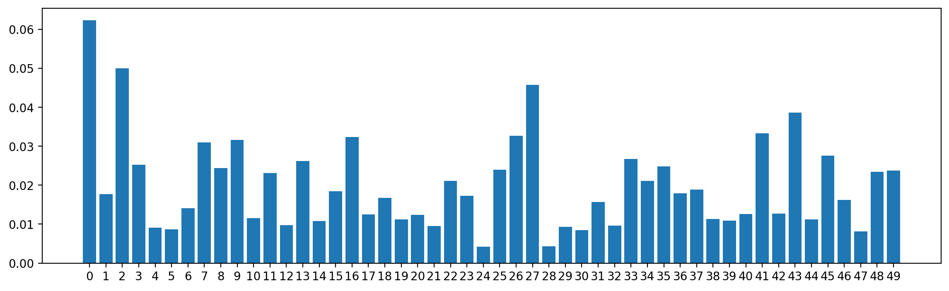
How data flows through a sequential model
PASS SEQUENCE PREDICTION USING LSTM
Make Prediction on Sequence at Each Cluster Map

Slide 7
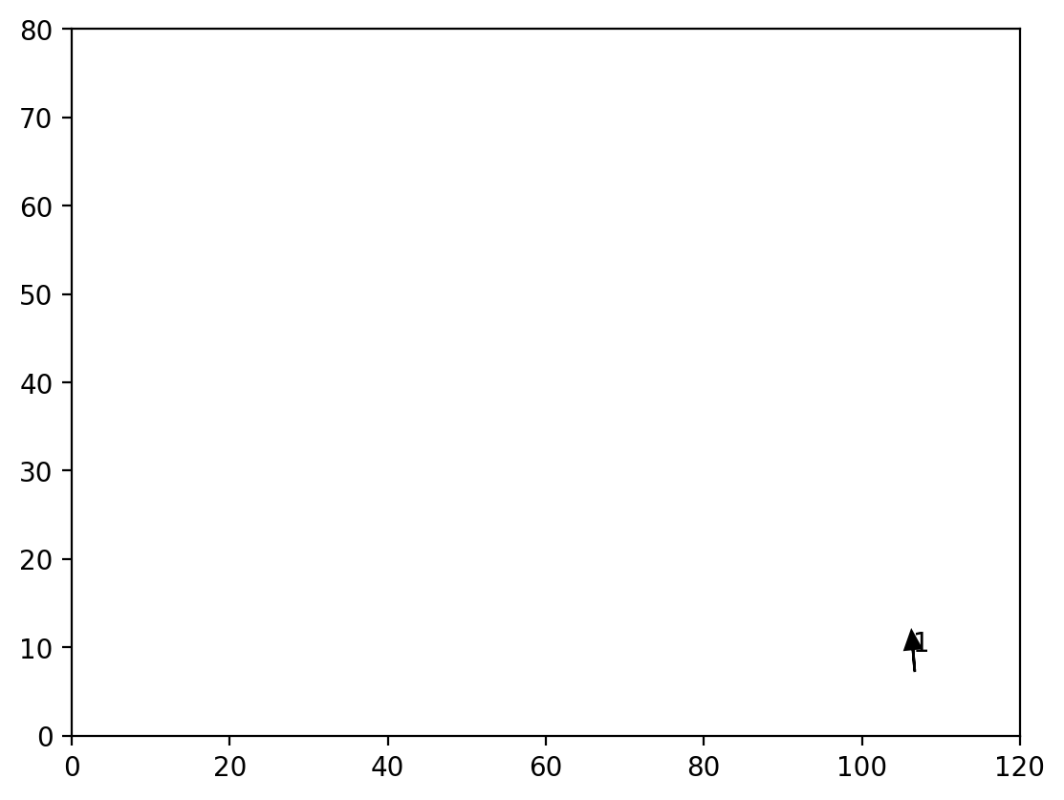
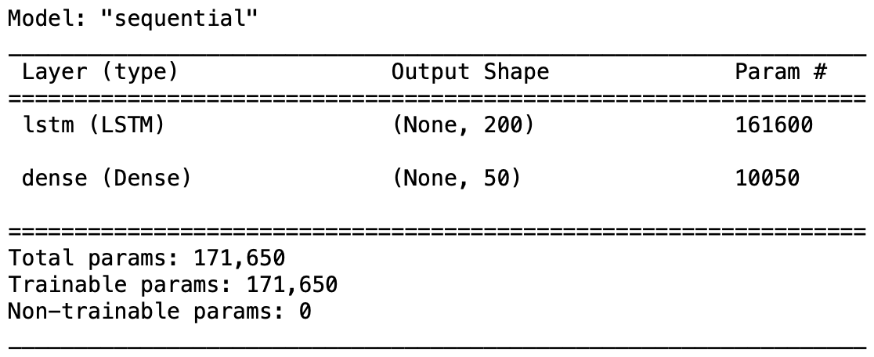
PASS SEQUENCE PREDICTION USING LSTM
Plot Possession Sequence, and Likely Next Passes
Sequential Model Summary

Slide 8
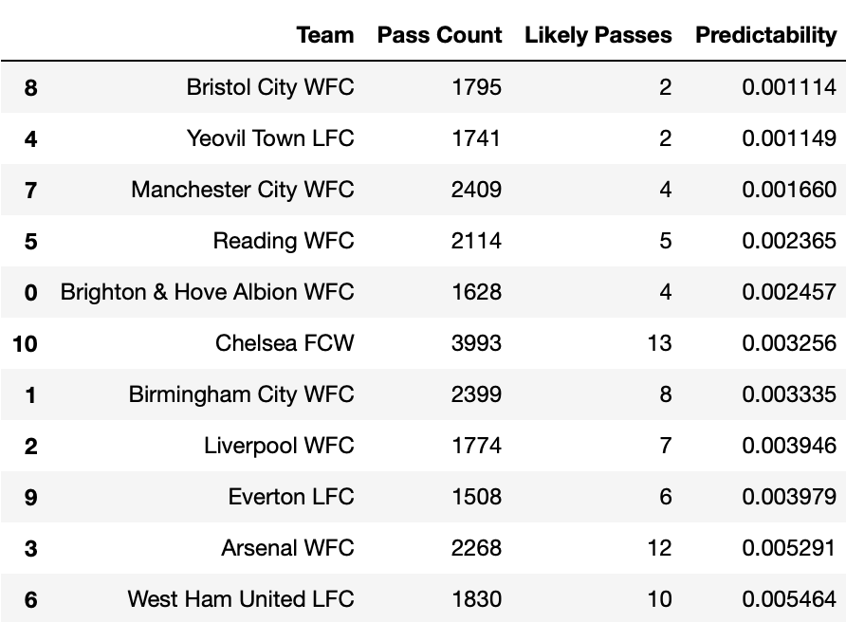
DataFrame of Each Team, Pass Count, Likely Passes and Predictability
EVALUATE TEAM BALL MOVEMENT
From the Sequential Model, Construct Training Data, we get Team Label list data and X_train. Make a Football Team list of passes and likely passes from Team Label list data. Make a Model Prediction on the entire Football Data set from X_train list data. Count the Pass Count and Likely Passes.

Slide 9
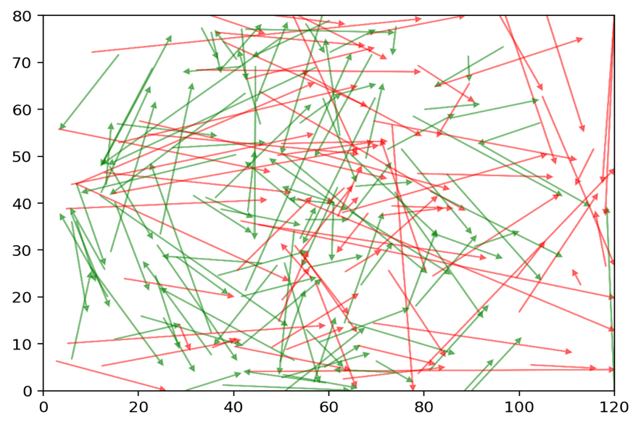
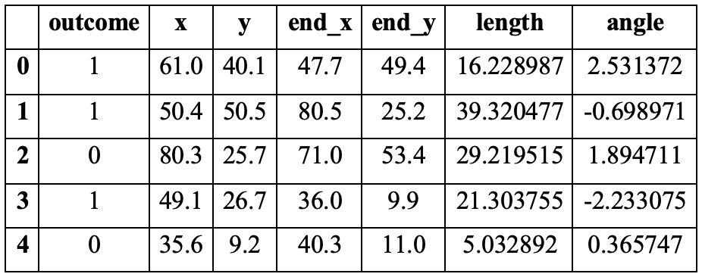
ESTIMATING PASSES DATA
Passes DataFrame between outcome, x, y, end_x, end_y and angle
Plot Football Match Passes Location

Slide 10
BUILDING A BASIC LOGISTIC REGRESSION MODEL
Once the model is created, you need to fit (or train) it. Model fitting is the process of determining the coefficients 𝑏₀, 𝑏₁, …, 𝑏ᵣ that correspond to the best value of the cost function. There is a feature combination of angle and length columns and labels are the outcome column.
% of Accuracy of Correct predictions is 76.16

Slide 11
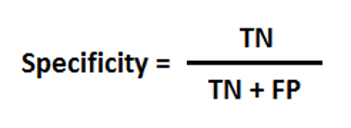
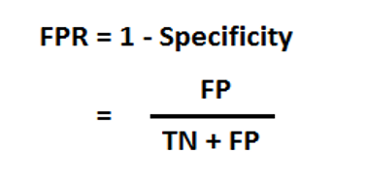
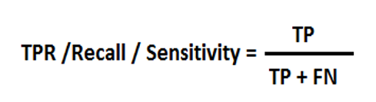
Evaluating Predictions using ROC
AUC - ROC curve is a presentation evaluation for classifying problems at numerous threshold settings
Confusion Matrix = array of [ ]
True Negatives, False Positives,
False Negatives, True Positives

Slide 12
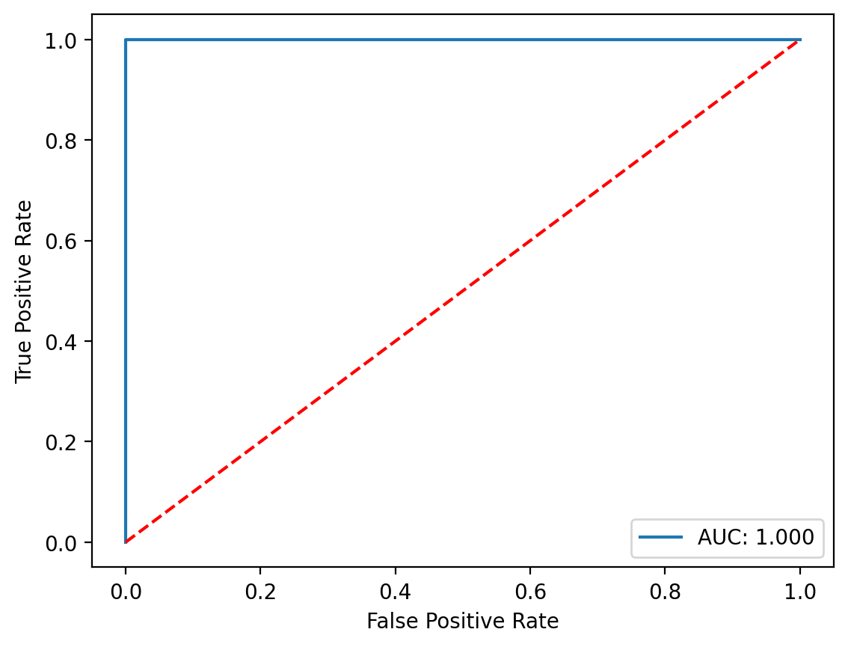
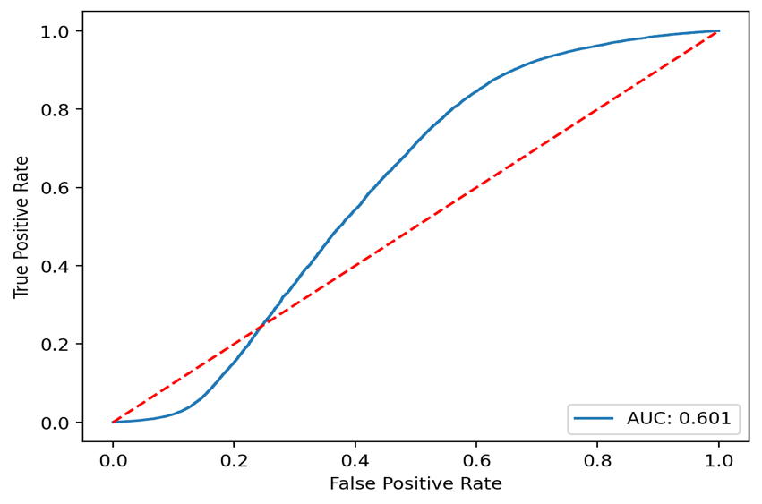
Draw ROC for regression predictions
Evaluating Predictions using ROC
Draw perfect ROC Curve

Slide 13
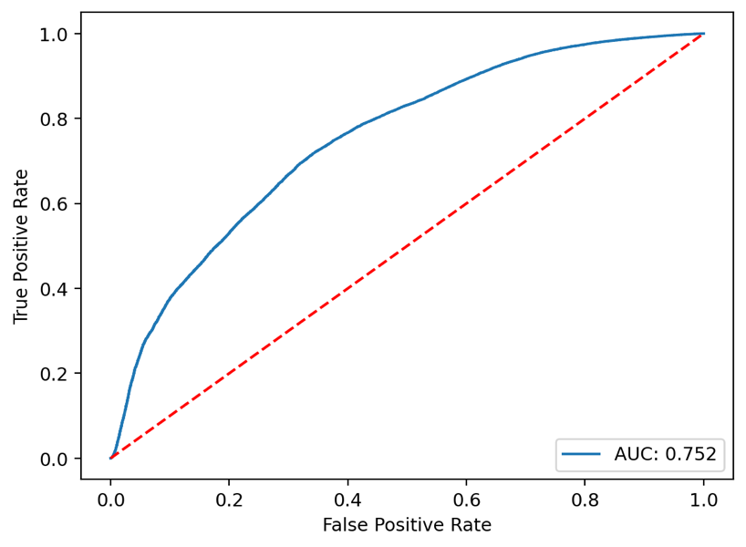
FEATURE ENGINEERING
Draw ROC between Labels and Predictions of Logistic Regression Where predictions of features as abs angle and length and labels an outcome

Slide 14
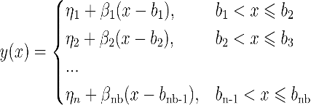
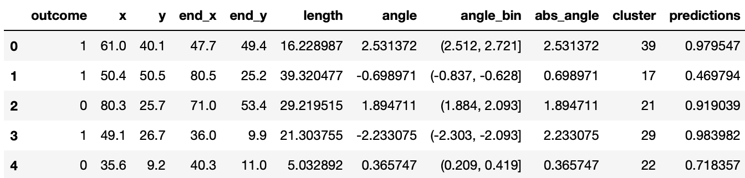
BUILDING PIECEWISE MODEL
Piecewise regression equation
Passes DataFrame between location, abs angle, bin angle, cluster & prediction

Slide 15
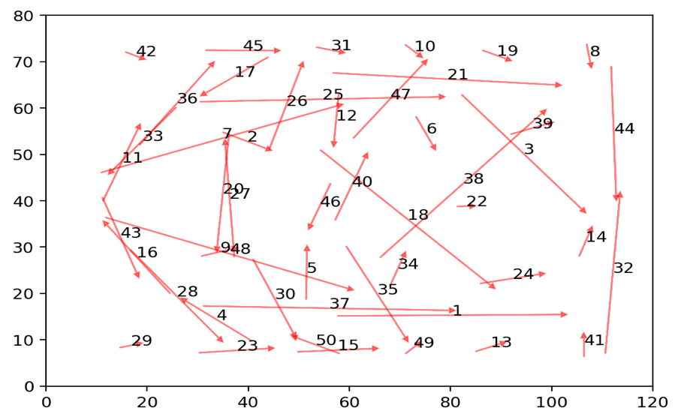
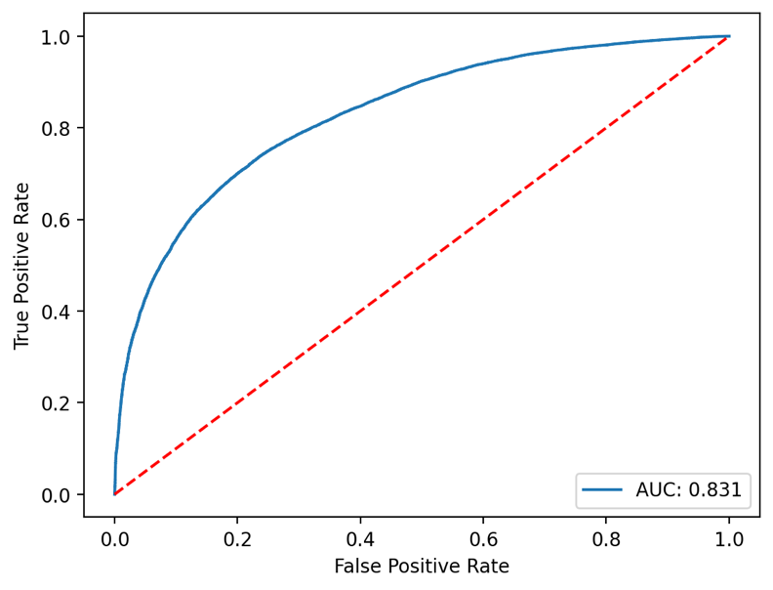
Cluster center of the model of Passes
Draw ROC of Final Piecewise Model where predictions of features as cluster, abs angle and length and labels an outcome

Slide 16
Comparing ROC Curves

Slide 17
Comparing ROC Curves

Slide 18
CONCLUSION
This thesis provides a research template with Pass Classification and Sequence, I state that K-Means Clustering Models and Sequential Neural Network Model trained suitable for evaluating Pass Count, Likely Passes, we found less evidence in favour of their Passes Predictability by Team Ball Movement. The Result of Passes Predictability is 0.11 to 0.55%.
The Logistic Regression Model and K-Means Cluster Model information for passes location are known. In this model, % of Overall Passes completed is 74.3% and % of Accuracy of Correct predictions of logistic regression is 76.16%. The AUC of the logistic regression model is 75.2% and the AUC of the final piecewise model is 83.1%, we get good AUC with compare with the LR model.
Football analytics has been the focus of professional football teams and academic research in recent years. Advances Thanks to several areas, such as data analytics tools, data collection, and machine learning, enormous progress has been made.

Slide 19
THANK YOU FOR YOUR ATTENTION

